Slide 1
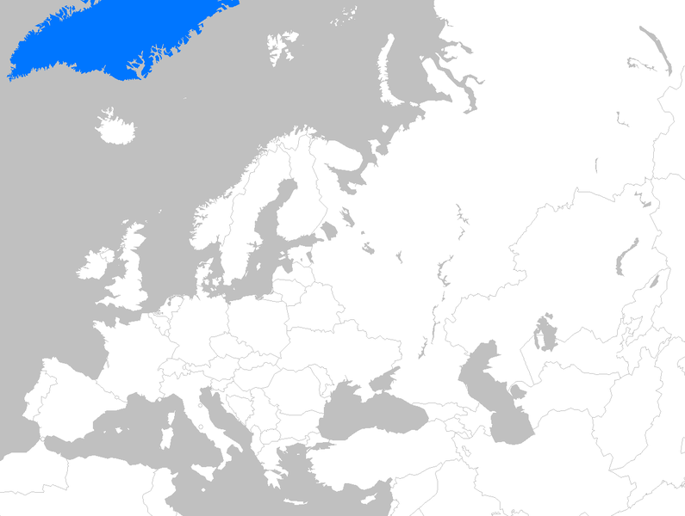
ABA in Iceland
Habilitation and supporting families in isolated areas and higher education
Sigridur Loa Jonsdottir
The State Diagnostic and
Counselling Centre
A European mini-symposium on Applied Behaviour Analysis and Autism: Introduction to the multimedia package “Simple Steps”
31st of January 2013
Stockholm University

Slide 2
Outline
Prevalence of Autism spectrum disorders (ASD)
ABA based intervention for children with ASD
The service system
Study results
ABA training and education
at different levels

Slide 3
Prevalence
Total population in Iceland: 319.000
An estimate of the prevalence of ASD in Iceland is now 120 in 10.000 children -1,2%
There are around 5000 births per year and about 60 children in each birth cohort are diagnosed with ASD

Slide 4
Intervention for children with autism in Iceland
Until the year 2000, young children with autism received eclectic treatment
Outcome: Jonsdottir, S.L., et al., (2007). Follow-up of Children Diagnosed with Pervasive Developmental Disorders: Stability and Change During the Preschool Years. Journal of Autism and Developmental Disorders, 37, 1361-1374.
The outcome was not as impressive as seen in groups of children receiving ABA based intervention

Slide 5
ABA based intervention Initial steps
Education and training at UCLA, 1993 –1994
The Multi-site Young Autism Project - a replication study of:
Lovaas, O.I. (1987). Behavioral treatment and normal educational and intellectual functioning in young autistic children. Journal of Consulting and Clinical Psychology, 55, 3-9
McEachin, J.J., Smith, T. og Lovaas, O.I. (1993). Long-term outcome for children with autism who received early intensive behavioral interventions. American Journal on Mental Retardation, 97, 359-372
Iceland Young Autism Project
1995-2000 – A group of children participated in an early intensive behavioral intervention (EIBI) outcome study
Outcome: See later in this presentation

Slide 6
ABA based intervention Initial steps
Consultation from Oslo (TIPO), 1995 – 2000
Consultation from Lovaas Institute of Early Intervention (LIFE), 1996-2002
Training of therapists/supervisors at Glenne Senter in Oslo, 1998 – 1999
Students educated and trained in ABA at universities abroad have returned to Iceland
Three are Board Certified Behaviour Analysts (BCBA)

Slide 7
ABA based intervention
An important step in the year 2000
It was decided to inform parents of newly diagnosed children with ASD about ABA based intervention in addition to the eclectic approach (mainly inspired by TEACCH) and offer them a choice
This decision was based on:
Increased awareness of high quality data based intervention
Increased interest and demand by parents for a comprehensive behavioral approach
Was made possible by the knowledge and the experience that the research project was generating

Slide 8
The service system Counselling and collaboration
Affiliation with the
University of Iceland
Collaboration with
institutions abroad
The State
Diagnostic and
Counselling Centre
Diagnosis
Reassessment
Data base
Research
Intervention
Team
Local communities
Specialised services
Counselling
Courses
Workshops
Preschool and
Home

Slide 9
ABA based intervention
After a child has been diagnosed:
Parents are informed about intervention options and offered to attend courses on ASD and intervention methods
An intervention team is established
Hands on training workshops
Further training of parents and tutors continues during regular team meetings and follow-up workshops that are offered for each team every few months

Slide 10
ABA based intervention
The legislature has provided children with handicaps the right to services at the preschool level and thus, intervention mainly takes place there
The preschools are run at a community level and provisions are made for special education for a specific number of hours per week depending on the child´s needs and condition, usually around 30 hrs. per week for a child with autism
One-on-one training and intergration into the group when appropriate
Parents work on generalizing skills to the home

Slide 11
Results

Slide 12
Experimental group Individual changes in IQ

Slide 13
Control group Individual changes in IQ

Slide 14
Results
Mean pre-treatment and follow-up scores on the Childhood Autism Rating Scale (CARS)

Slide 15
Ongoing ABA outcome studies
Atli F. Magnusson, Helga Kristinsdottir, Anna-Lind Petursdottir & Sigridur Loa Jonsdottir. Early intensive behavioral intervention for children with Down´s syndrome.
Atli F. Magnusson, Helga Kristinsdottir, Anna-Lind Petursdottir & Sigridur Loa Jonsdottir. Outcome of early intensive behavioral intervention for children with developmental disabilities.
Kristin Gudmundsdottir, Zuilma Gabriela Sigurdardottir & Shahla Ala´i-Rosales. Rural Consultation Models: Early behavioral Intervention for Young Children with Developmental Disabilities.

Slide 17
ABA training and ecucation Parents and professionals
The SDCC offers a sequence of courses and training workshops for parents and professionals based on ABA principles (total 82 hrs.)
The courses are offered:
In the capital area/at our center
In remote areas (training workshops)
Through the internet

Slide 18
Enhancing competence in remote areas
Enhancing competence by the use of new technology in Vest Norden
A Developmental project in collaboration with:
Nasjonalt senter for telemedisin – Universitetssykehuset Nord Norge
WHO Collaborating Centre for Telemedicine
http://www.helsekompetanse.no/

Slide 19
ABA training and ecucation At university level
The universities in Iceland offers a range of courses based on the science of ABA
Resources have not been pulled together to meet the academic course work requirements to sit for an examination to become a Board Certified Behaviour Analyst (BCBA)
The University of Iceland and the University of Akureyri are now working at this

Slide 20
ABA training and ecucation At university level
Reykjavik University will be offering a new master´s program in psychology (fall 2013)
Evidence based methods and practices in the field of psychology – will include a strong ABA component
The courses are adapted from the Behavior Analyst Certification Board (BACB) Course Content Requirements for Board Certified Behavior Analysts
Local and international supervised practicum for students
A graduate diploma in ABA will be possible (without practicum)

Slide 21
Needs and challenges
To increase the quality of ABA based intervention for children ith ASD
Lack of well trained tutors and supervisors
Education, training and supervision
Increase the number of BCBA’s and BCaBA’s
No material on ABA is available in Icelandic
Simple Steps will provide a much needed educational material in Icelandic with an easy access to everyone

